Slide 1
Safe Quiet Lakes
Our mission: to make the Muskoka lakes safer and quieter, to ensure the sustainable enjoyment of a treasured shared resource.
Notes:
Our group was formed by concerned members of the lake community in 2011. We are people who love the lakes and life on and near water.
Most of our lakes are mixed use, but there is more and more activity on the lakes and according to the OPP more accidents and more complaints
It just makes sense: we are adding more, different, bigger and faster craft into a finite space and therefore there are more conflicts and issues
We value the lake community so we decided to try to help. We aren’t the first and we won’t be the last. But we have momentum and support and we think our movement will make a difference.

Slide 2
Agenda
Welcome & Introductions - Frances Carmichael, Chair
2015 Results and plans for 2016 - Greg Wilkinson, Chair Advocacy and Research
  Introduction of 2016 Quiet Campaign
  Sgt Todd Selvage, OPP Bracebridge Detachment and Sgt Steve Mihills OPP S.A.V.E Team
Panels Presentations
  Jasmine Northcott, CEO, WakeBoard Canada
  Capt. Craig Hamilton, Boater Skills
  John Bowlby, Commodore and Director, Muskoka Lakes Association
  Dawn Callan, PaddleSmart Program and National Paddling Week Co-ordinator, Paddle Canada
Group Discussions and Report back on key boating issues
Wrap-up

Slide 3
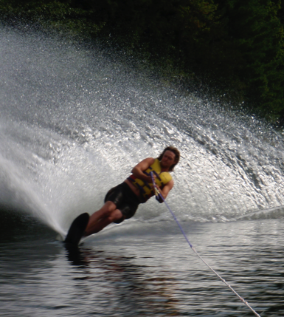
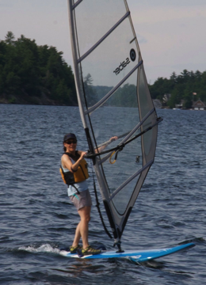
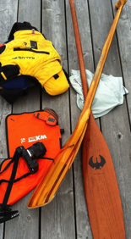
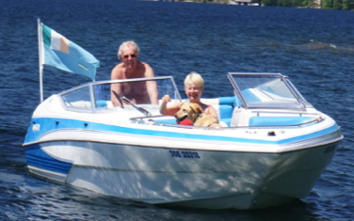
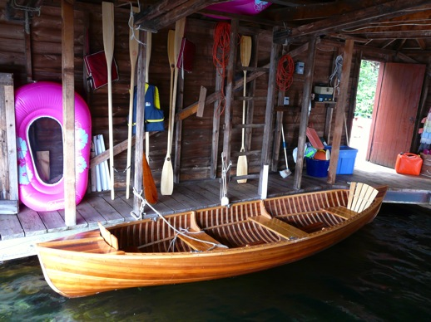
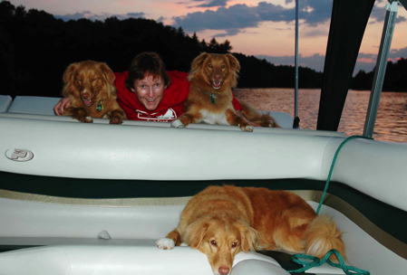
We are Boaters!
Notes:
Who we are:
A group of cottagers and residents who were concerned about increased speed, noise and inconsiderate behaviour of a growing number of boaters. We came together in autumn 2011.
Many volunteer driven lake association meetings had raised the same issues; law enforcement officers confirmed our concerns were on the increase; environmental damage was also escalating broadly.
By April 2012 we assembled our first stakeholder consultation meeting and were overwhelmed by the 50+ attendance including associations, law enforcement, elected officials and regional grassroots organizations.
In April 2103 we welcomed 83 participants at the 2nd stakeholder meeting including Jonathan Doan and Tania Havelka from Transport Canada Ontario Region
Our volunteers include communication professionals, designers, research professionals, social media experts, lawyers, professional accountants and individuals with extensive experience in marine safety and watercraft manufacturing – all providing their expertise on a pro bono basis because – WE CARE
1. Safe, quiet boating makes our lake community enjoyable for all.
2. The lakes are a shared space; showing respect for diverse activities on the water and the people on the shore is part of our Muskoka culture.
3. We can all do something about the disrespectful boating, excessive speed, noise and wakes that degrade the lake environment we treasure.

Slide 4
Our message:
“Boaters Always Care”
Boaters operate with caution and courtesy.
Always keep a 360° watch and minimize wake and noise.
Care for passengers, respect regulations and offer PFD’s.

Slide 5
Thank you to our Supporting Partners
MUSKOKA LAKES ASSOCIATION
LAKE JOSEPH NORTH ASSOCIATION
SEGUIN TOWNSHIP
Lake of Bays Association
Little Lake Joseph Association
Township of Muskoka Lakes
Bracebridge
Lake Rosseau North Association
Muldrew Lake Cottage Association
Loon And Turtle Lake Association
South Muskoka Lakes Community Association
Grandview Lake Association
Otter Lake Ratepayers’ Association
Paint Lake Ratepayers’ Association
Three Mile Lake Association
and many individuals – Thank You !
**Donors in FY 2015/16

Slide 6
2015 Research
Safe Quiet Lakes Impact
*Thanks to Erin Research

Slide 7
Four Core Concerns
The most commonly cited problems are:
Boats going too fast too close to shore
Loud boat engines
Large wakes
Unsafe and inconsiderate boating
Notes:
We took the results of the survey and distilled them to these 4 core concerns.
The overwhelming solution that was identified is more and better education and communications.- Call for more education and communication by over 60%
And Over 60% of respondents would support “more regulation that limits on the amount of noise that boats can make”
Call for more education and communication by over 60% of respondents
Do not add regulations on top of regulations (with one exception); enforce existing laws on reckless boaters, alcohol use, above water exhausts
Over 60% of respondents would support “more regulations that limit the amount of noise that boats can make
What are the issues?
Boats going too fast too close to shore (particularly PWC’s)
Loud boat engines
Large wakes (from wake board boats but also poor, inconsiderate wake management by many)
Dissatisfaction with the current PCOC – has it become an invincible “superman cape”
Inconsiderate boating
Failure to follow the rules
Swimmers in open water
Distribution: strong majority in the “we can work this out” middle, with fewer - but very passionate – other points of view

Slide 9
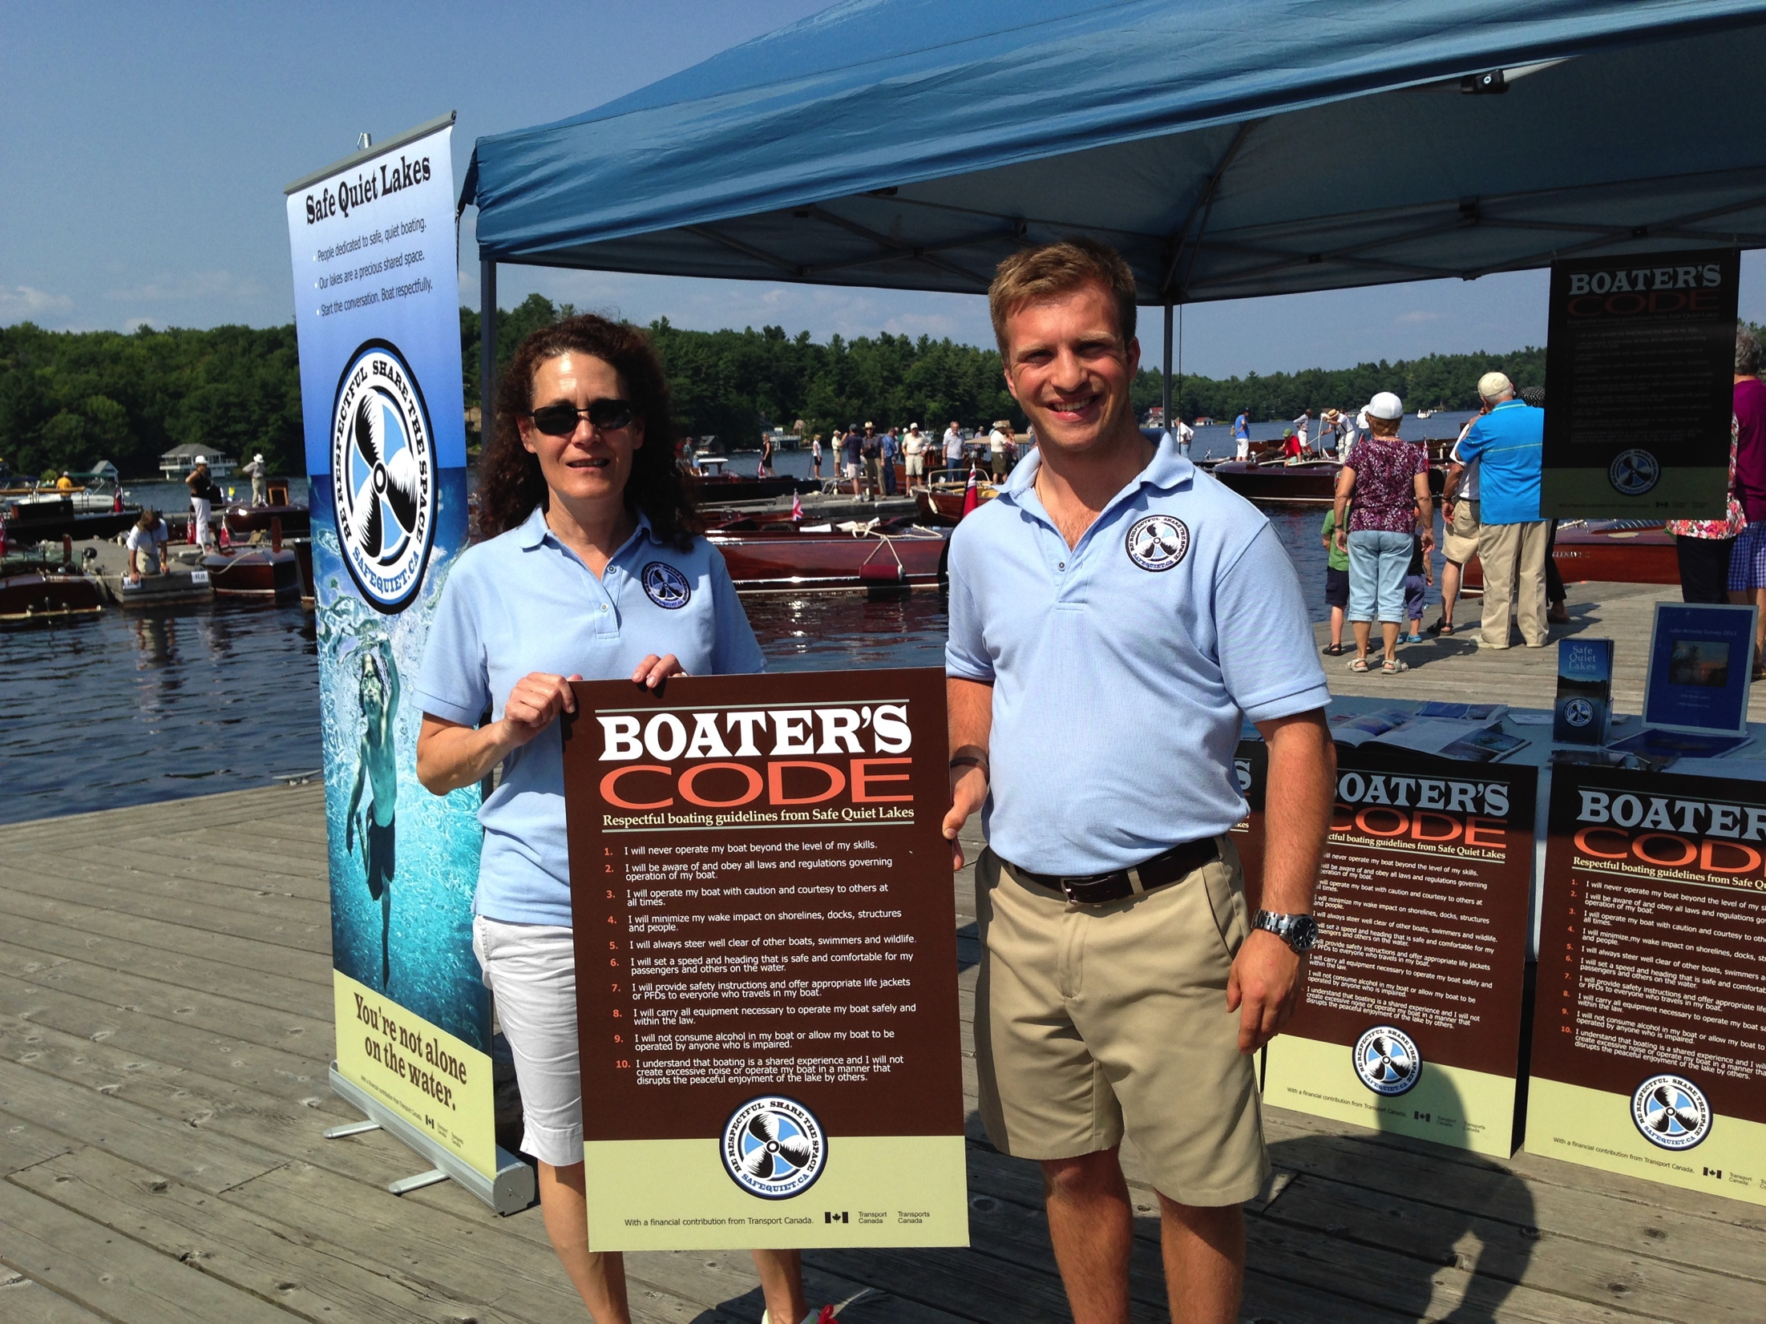
2015 – Further Extended Reach
Summer 2015
Total of 75 Boater’s Code signs since 2013:
  34 at marinas including: Pride, Port Sandfield, Muskoka Warf,
  8 at local resorts and boating oriented businesses including Marriott and Deerhurst
  17 at public boat launches in Town of Muskoka Lakes and Seguin including the locks
  15 by lake associations
Attended 22 boating oriented events and AGM’s
Distributed over 6100 Boater’s Code cards, 1700 Right of Way stickers, and 1200 brochures.
Over 8000 page views on the website by 4800 users
Notes:
Marinas also received a supply of Boaters Codes cards to distribute to customers at the gas dock or, if desired, to services or new boats. Right of Way stickers were mailed or given to each marina as well.

Slide 10
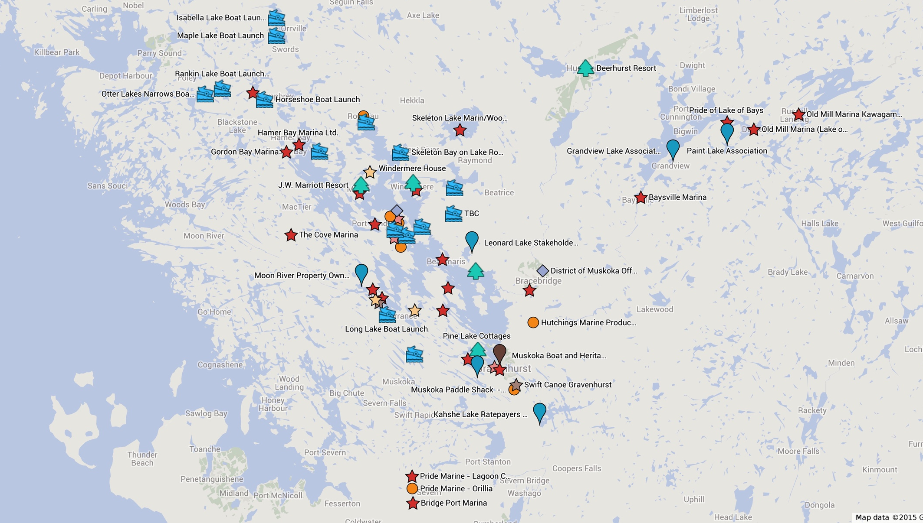
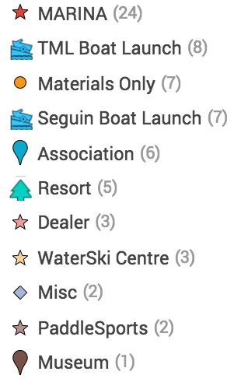
Code Signs Installed Since 2013
Muskoka & beyond
<-These 3 are Pride locations off the map
Total of 75 Signs

Slide 11
2016 PLANS
Education and Communication
  “Quiet Campaign”
  Website relaunch
  Boaters Always Care outreach to marinas, resorts, lake associations, retailers and presence at events
  Toolkit for Lake Associations
  Cooperation with like-minded groups
Advocacy
  Engaging governments
  Evaluating policy options with partners
  NMMA “Summit” on recreational boating
Resource development
  Fundraising
  Volunteer recruiting

Slide 12
Ongoing cooperation with NMMA
“On May 3rd, NMMA will be hosting a one day Recreational Boating strategic planning session to discuss key issues.
We have invited Safe Quiet Lakes to attend this important milestone event.”
    Sara Anghel, NMMA
Notes:
Dear Colleagues,
It is a great honour again to be invited to participate in this important meeting today, unfortunately, due to some previously scheduled travel, I am not able to attend in person. I am in Singapore speaking about effective government relations to an Asian Boating Forum.
NMMA Canada continues to liaise with Safe Quiet Lakes so that together we can manage issues affecting boaters and non-boaters.
On May 3rd, NMMA will be hosting a one day Recreational Boating strategic planning session where we will bring representatives from all aspects of the industry to discuss key issues like safety, boating participation, growing the industry, environmental impacts and many other issues important to us all. We have invited Safe Quiet Lakes to attend this important milestone event. Other organizations present include: marine trades associations from across Canada, Canadian Safe Boating Council, the CPS, manufacturers, Paddle Canada, Sail Canada, the law enforcement community to name a few.
We look forward to an active day which will help to identify our priorities and challenges as an industry.
I wish you a productive meeting today and I look forward to continuing to work with all of you.

Slide 13
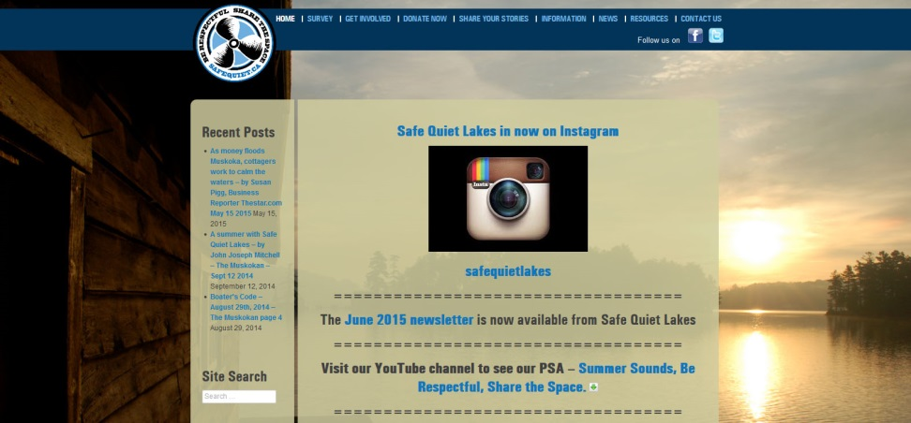
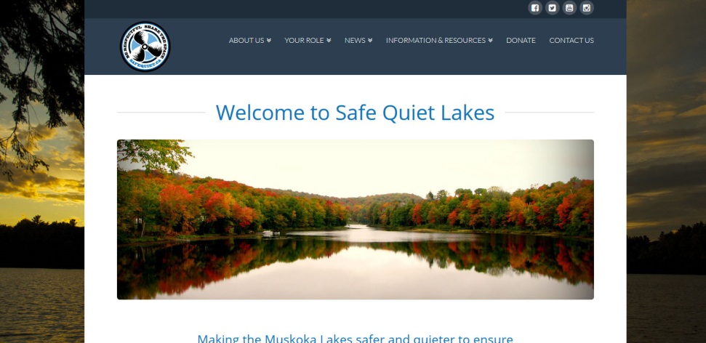
New safequiet.ca offers more clean and streamlined design

Slide 14
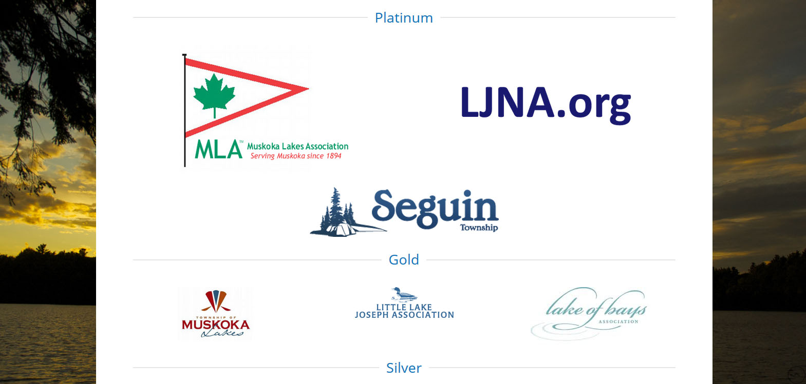
Prominent sponsor placement, allowing for recognition and thanks to partners

Slide 15
Quiet campaign aims
  Educate boat operators about safe/respectful norms and culture
  Increase awareness of the noise issue among boaters and changes boaters can make today
  Encourage compliance with laws and advocate with governments to make current laws more enforceable
  Partner with the OPP on education/outreach
  Work with the boating industry to encourage adoption of standards that value quieter options

Slide 16
Quiet campaign direction
Public relations outreach
  Celebrity endorser
  OPP ride-along
  Traditional and social media strategy
Creative options

Slide 17
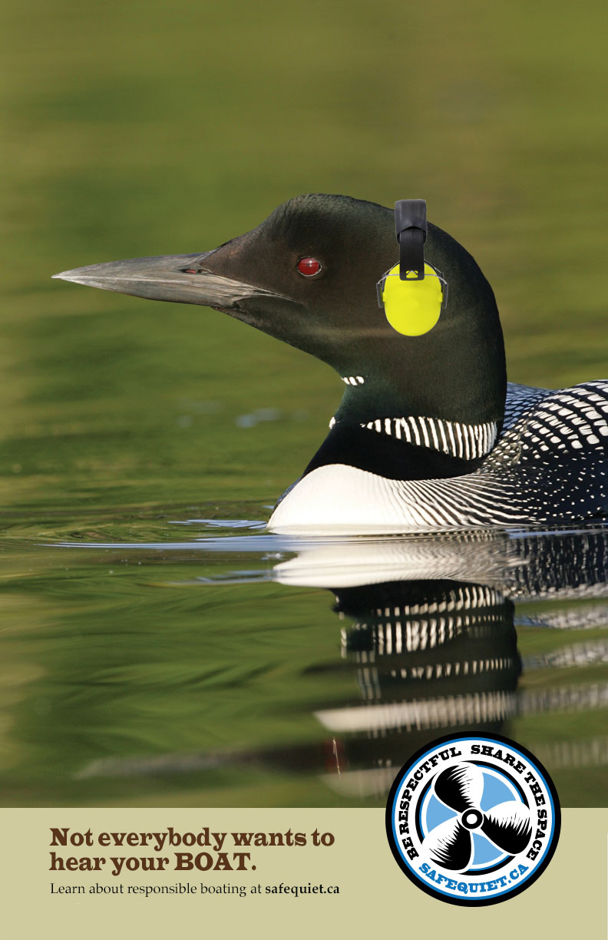
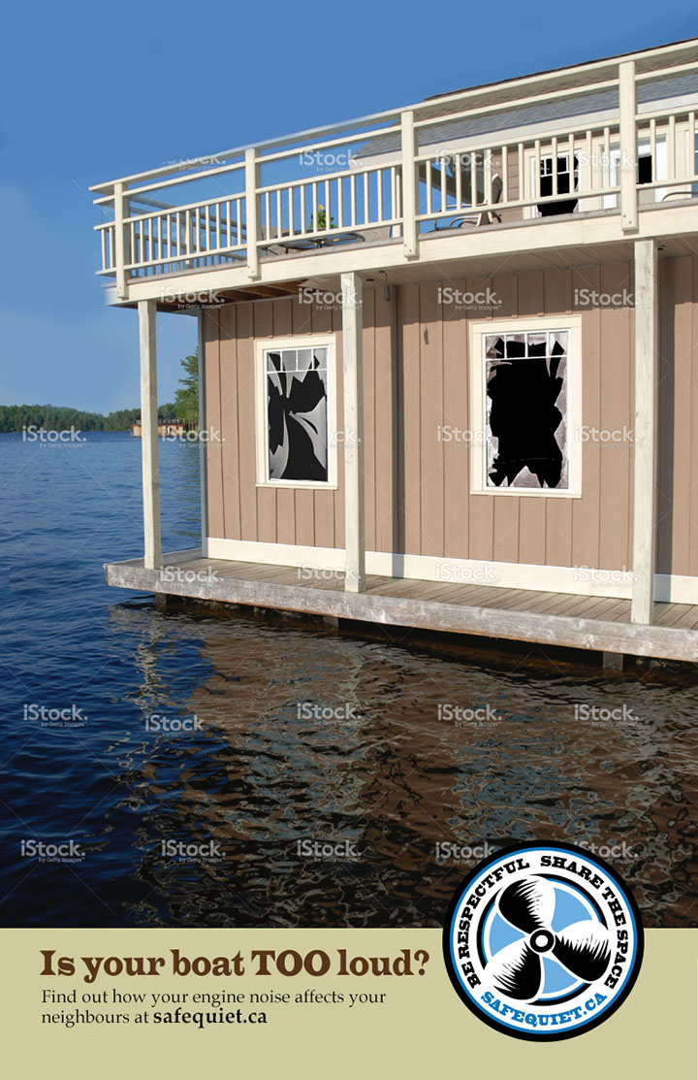

Slide 18
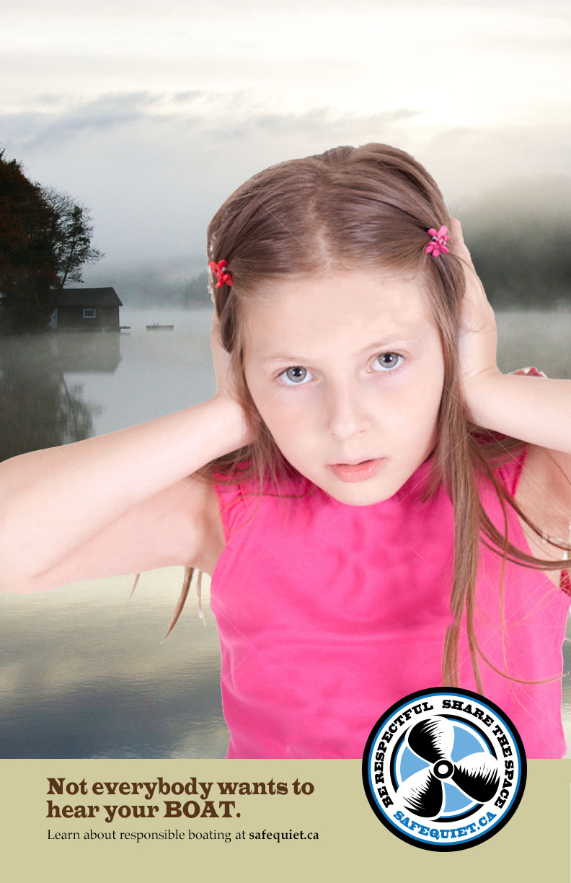


Slide 19



Slide 20
Boaters Always Care
Join us at SafeQuiet.ca

